Slide 1
Introduction To Hypervisor and Virtualization Research
Vignesh.C

Slide 2
AGENDA
About Me
Introduction To Virtualization
Introduction To hyper-V
Virtualization History
Intel Vt-x At a glance
Architectural Breakdown + Attack Surface
Virtualization Vulnerablity Research
Fuzzing Hypervisor

Slide 3
ABOUT ME
Speaker for threatcon,balccon and 0xcon
Hackthebox global top 10
Redteamer and security Researcher

Slide 4
What I need to learn to kick start hyperv
Strong experience in C (or C++) programming.
Familiarity with the x86_64 architecture, such as privilege levels, interrupts, page tables, and system registers.
System programming experience, such as kernel-module development, is a plus but not a requirement
Key concepts of VT-x and programming interfaces
Various applications of hypervisors in the real world and how they are implemented, examples include:
System hardening, such as HVCI and KDP on Windows
System-level fuzzing, such as What The Fuzz
System-level inspection and rootkit, such as antivirus-hypervisors
Early OS boot activities and handling of them as a hypervisor
Subtle yet complex concepts such as control register access, memory types, caches invalidation, and emulation of those

Slide 5
Introduction To Virtualization
Virtualization is the technique of making one thing look like many things, or many things look like one thing. It’s like magic, but with computers. For instance, you can use virtualization to run multiple operating systems on one machine, or to make one machine act like a whole network.

Slide 6
Why Virtualization
Mainly for fun. If you compare hypervisors to browsers,the latter have roughly same amount and complexity of technological stacks, with less depth.
A typical hypervisor system spans multiple privilege boundaries, talks to hardware, and embraces all mainstream OS’s at the lowest level

Slide 7
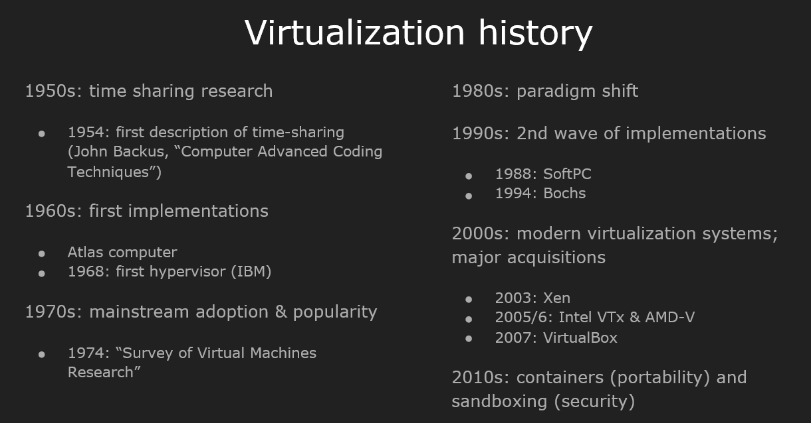
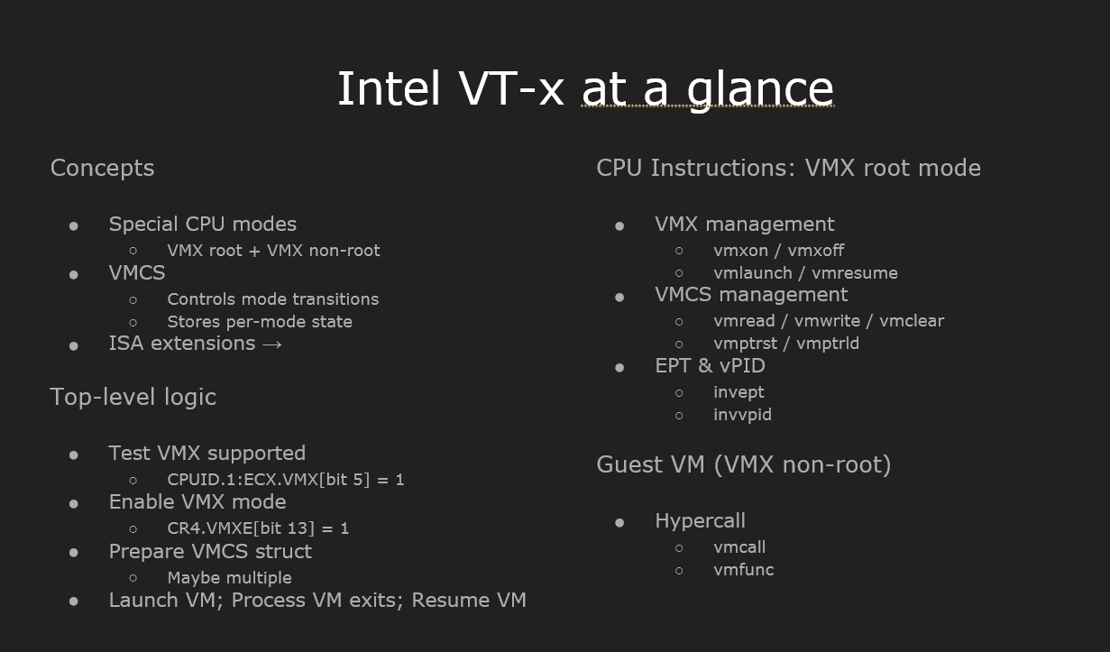
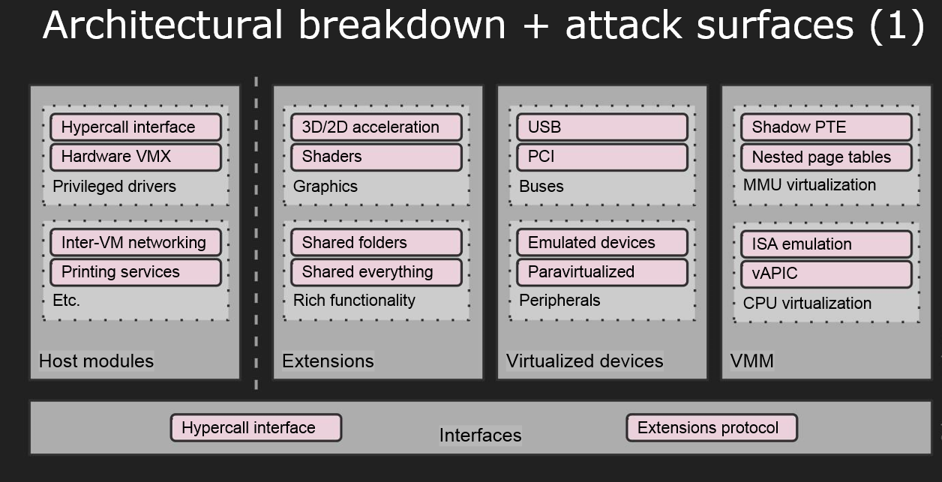

Slide 8
Attack Surface Techniques
There are many interfaces to access the hypervisor from the root partition:
Hypercalls handlers
Faults (triple fault, EPT page faults, etc.)
Instruction Emulation
Intercepts
Register Access (control registers, MSRs)

Slide 9
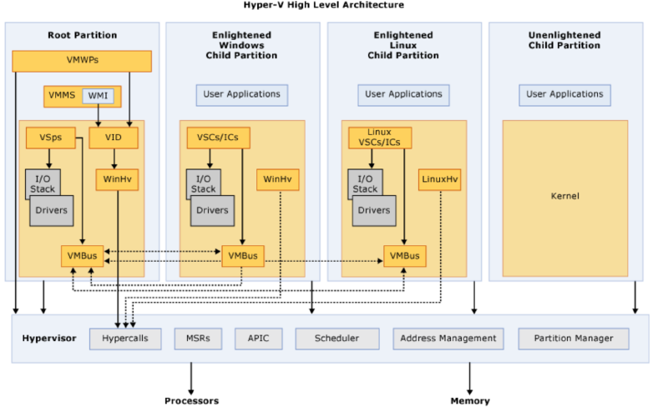
Hyper V High level architecture

Slide 10
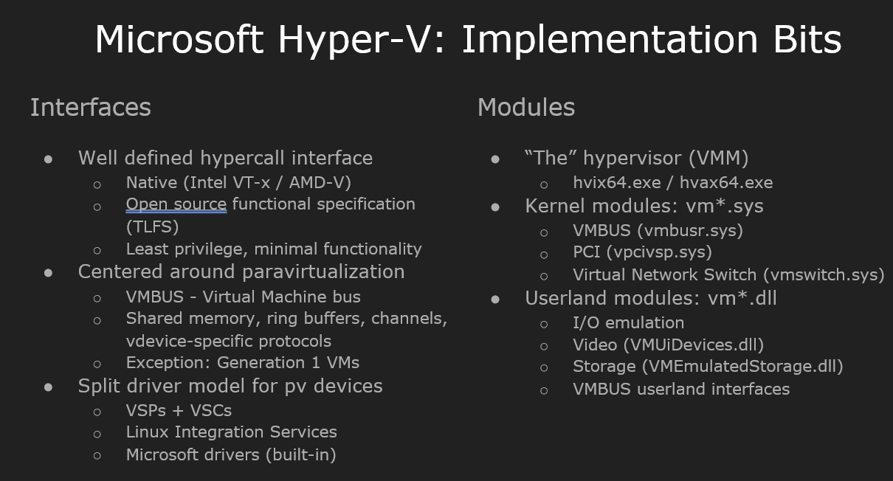
Hyper V Hypercalls
Hyper-V is a hypervisor-based virtualization technology that enables multiple operating systems to run on a single physical machine. Hypercalls are the mechanism used by the hypervisor to communicate with the guest operating system.
Each hypercall defines a set of input and/or output parameters, which are specified in terms of a memory-based data structure. There are two classes of hypercalls: simple and rep (short for “repeat”). A simple hypercall performs a single operation and has a fixed-size set of input and output parameters. A rep hypercall acts like a series of simple hypercalls

Slide 11
Types of Faults
A page fault occurs when a program requests an address on a page that is not in the current set of memory resident pages. When a page fault occurs, the thread that experienced the page fault is put into a Wait state while the operating system finds the specific page on disk and restores it to physical memory.
A triple fault is a special kind of exception generated by the CPU when an exception occurs while the CPU is trying to invoke the double fault exception handler, which itself handles exceptions occurring while trying to invoke a regular exception handler.
An EPT page fault is a type of page fault that occurs when the Extended Page Table (EPT) mechanism is enabled and a virtual machine attempts to access a memory page that is not present in the EPT

Slide 12
Instrumentation Simulation
Instruction simulation is a technique used in security research to simulate the behavior of a system or environment in order to identify vulnerabilities and test security measures. It involves creating a virtual environment that mimics the real system or environment, and then running simulations of various scenarios to see how the system or environment responds.
This can help researchers identify potential security threats and develop effective countermeasures. For example, instruction simulation can be used to test the effectiveness of intrusion detection systems, firewalls, and other security measures.
By simulating different types of attacks and observing how the system responds, researchers can identify weaknesses and develop strategies to improve security.

Slide 13
Intercept in Hyper V
In hypervisor-based virtualization, an intercept is a mechanism that allows the hypervisor to monitor and control the execution of guest operating systems.
Intercepts are used to enforce security policies, manage resources, and provide virtual devices to guest operating systems. For example, when a guest operating system attempts to access a physical device, the hypervisor intercepts the request and emulates the device in software.
This allows the hypervisor to control access to the physical device and ensure that the guest operating system does not interfere with other guests or the hypervisor itself. Intercepting system calls is another common use case for hypervisors in security research

Slide 14
What I need to learn to kick start hyperv
Basics of Hypervisors: Hypervisors are complex software systems that require a good understanding of computer architecture, operating systems, and virtualization. You should start by learning the basics of hypervisors, such as their architecture, types, and functions.
1
Hypervisor Security: Hypervisors are critical components of virtualized environments and are often targeted by attackers. You should learn about the common security threats and vulnerabilities associated with hypervisors, such as VM escapes, memory leaks, and privilege escalation.
2
Hypervisor Debugging: Debugging hypervisors is a challenging task that requires advanced skills in reverse engineering, assembly language, and kernel programming. You should learn how to use debugging tools such as IDA Pro, WinDbg, and GDB to analyze hypervisor code and identify vulnerabilities.
3
Hypervisor Testing: Testing hypervisors is an essential part of security research. You should learn how to use testing tools such as fuzzers, emulators, and virtual machines to test hypervisors for security vulnerabilities.
4
Hypervisor Development: Developing a hypervisor is a complex task that requires advanced skills in software engineering, computer architecture, and operating systems. You should learn how to develop a hypervisor from scratch using tools such as QEMU, KVM, and Xen.
5

Slide 15

THANK YOU

